Slide 1

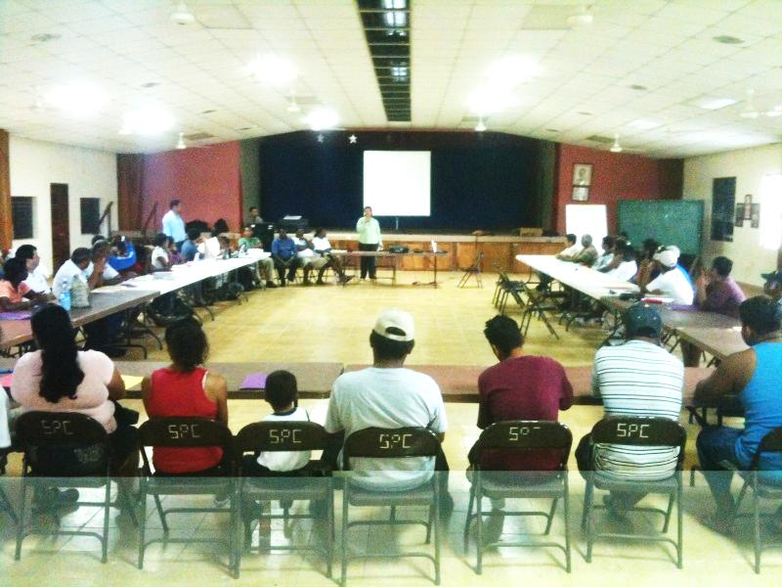
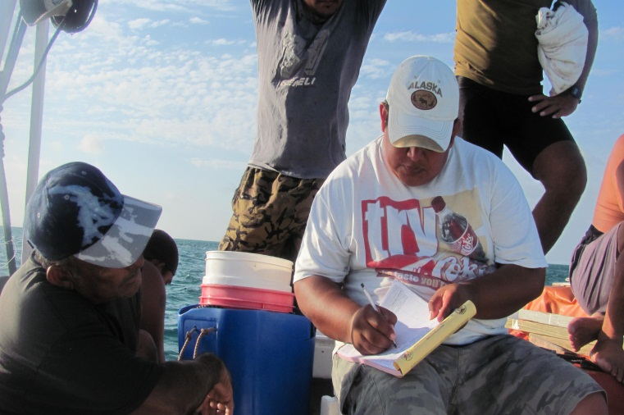

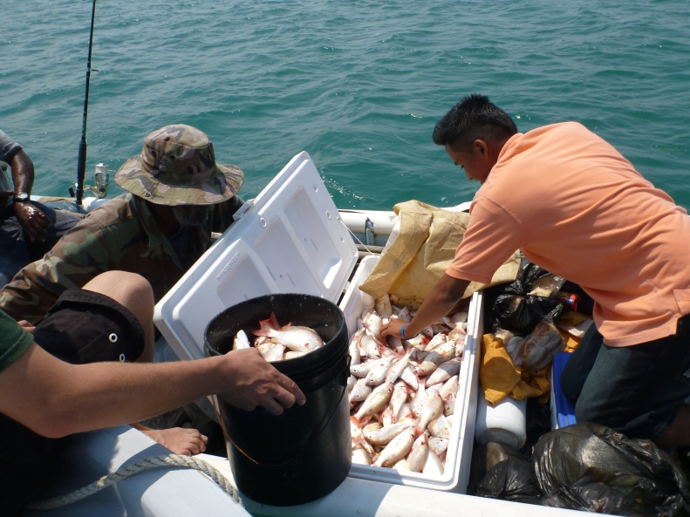
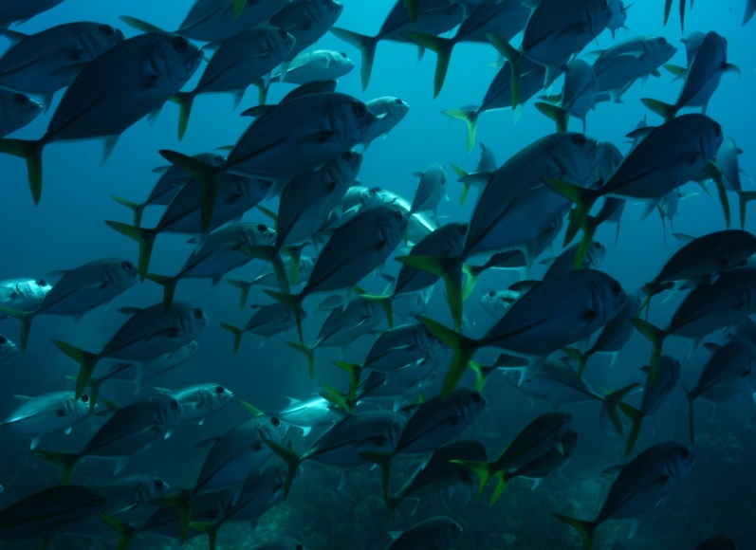




Managed Access
Moving Towards Collaborative Fisheries Sustainability in Belize
James R. Foley, MSc.
Toledo Institute for Development & Environment (TIDE) Belize
+ 501 722-2274
jfoley@tidebelize.org www.tidebelize.org
Attendance supported by

Slide 2
Background:
Fisheries and Belize

Slide 3
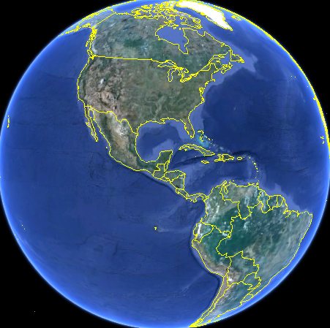
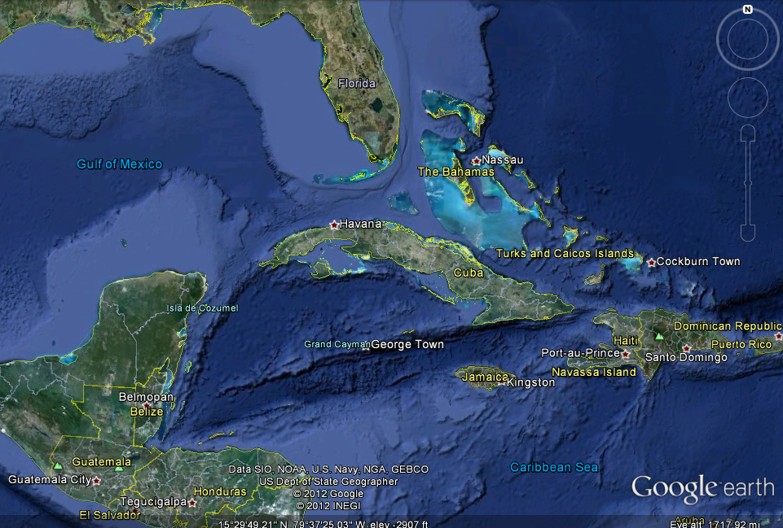
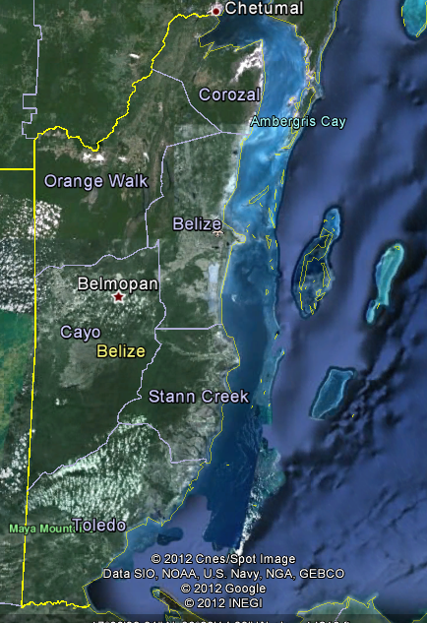

Mesoamerican
Barrier Reef
James R. Foley MSc.| Toledo Institute for Development and Environment (TIDE) | Managed Access in Belize: ICRS 2012| Background

Slide 4
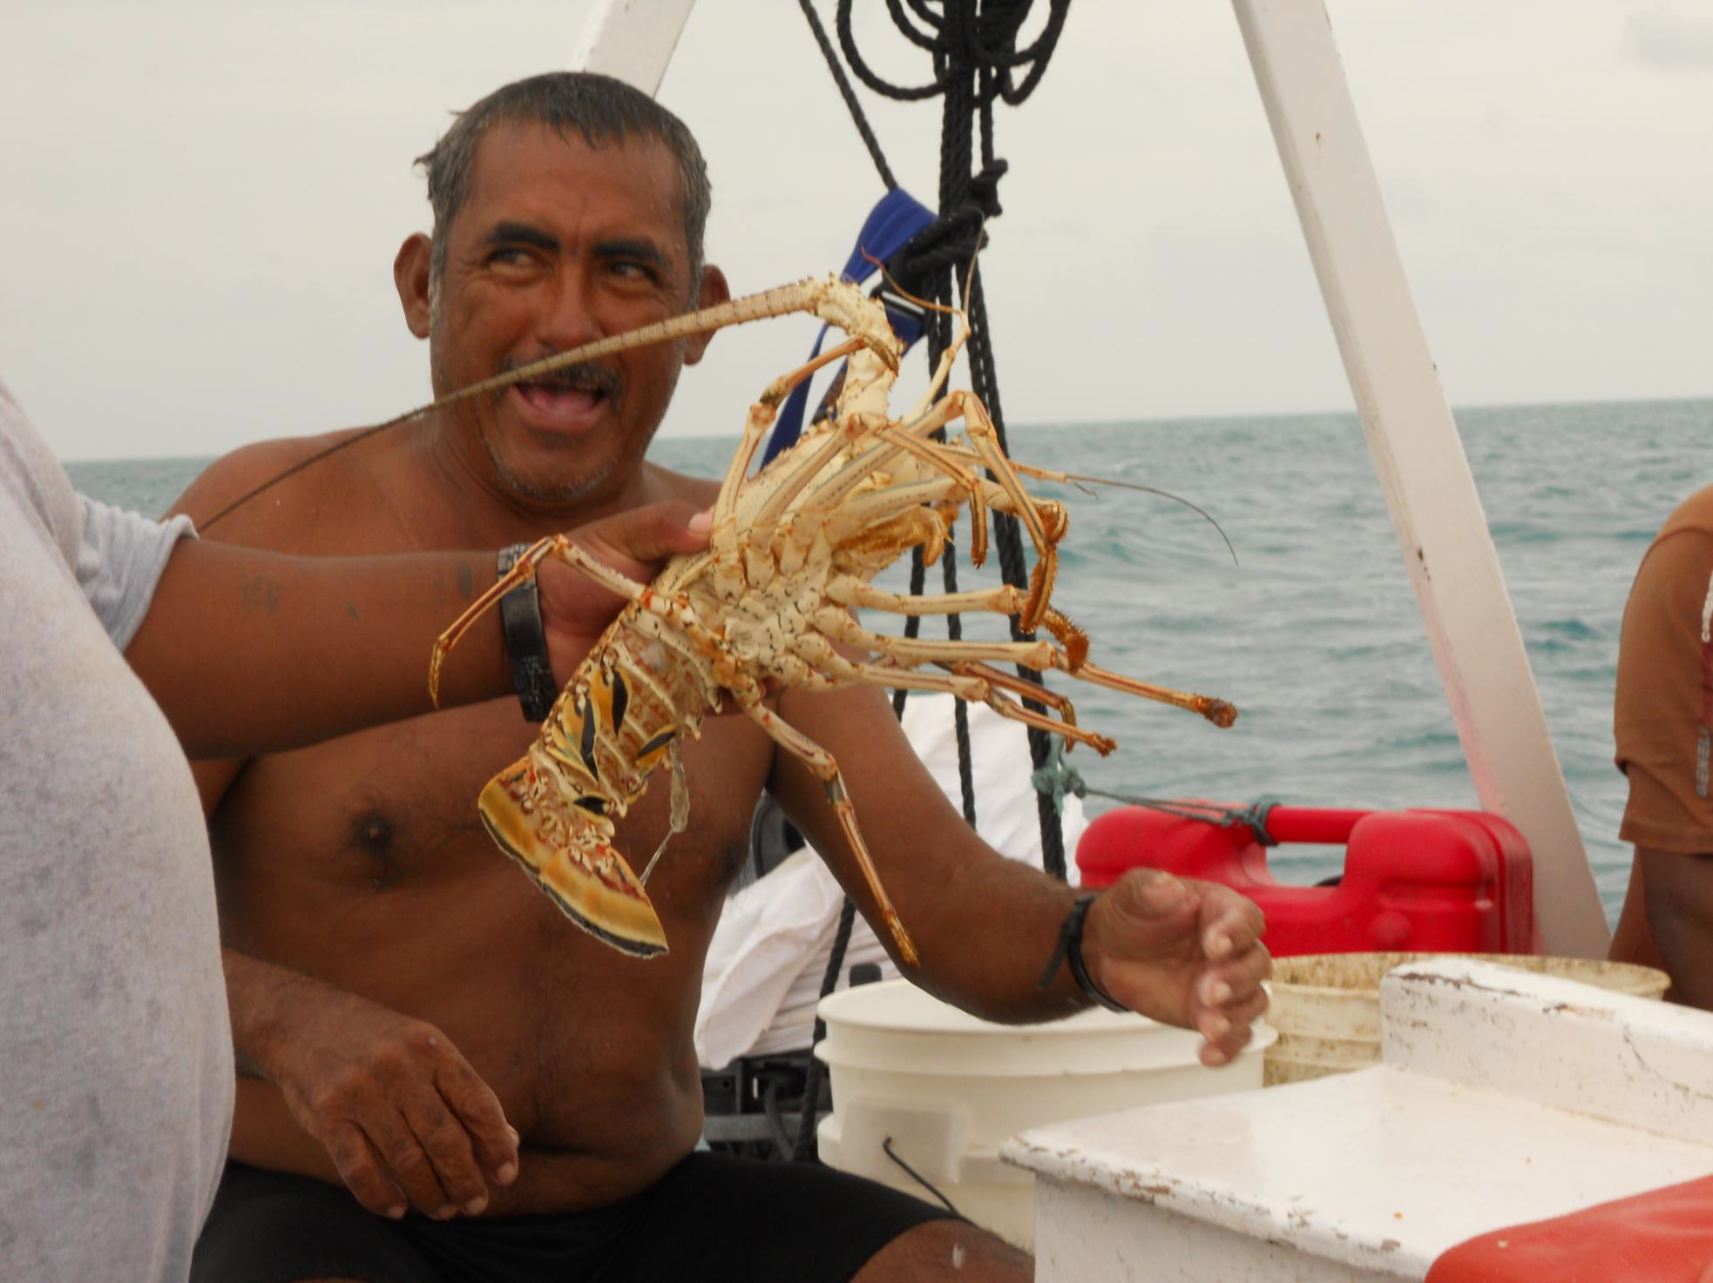
Belize Fisheries: Lobster & Conch
Total fishery: US$10.8 million in 2010
Caribbean Spiny Lobster (Panulirus argus)
  most economically important: 60% of total in 2010
  Conch (Strombus gigas) also important
>2,400 fishermen directly employed in capture fisheries sector
~15,000 citizens indirectly employed in processing and exporting
Source: Wade et al. 2011
Photo: L. Epstein
James R. Foley MSc.| Toledo Institute for Development and Environment (TIDE) | Managed Access in Belize: ICRS 2012| Background

Slide 5
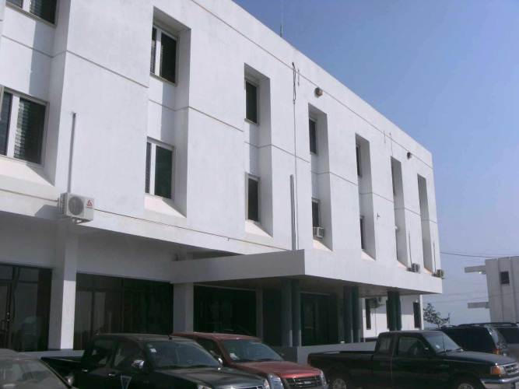
Belize Fisheries Department
Partners with NGOs and community:
  builds transparency and trust between government and society.
Progressive approach:
  regionally unrivalled Network of Marine Reserves
  Many Fish Spawning Aggregation Sites protected
  Gear Restrictions and Season Closures
  Bans on extracting certain marine species
Result:
  Belize's marine resources in better condition than many neighbouring countries.
James R. Foley MSc.| Toledo Institute for Development and Environment (TIDE) | Managed Access in Belize: ICRS 2012| Background

Slide 6

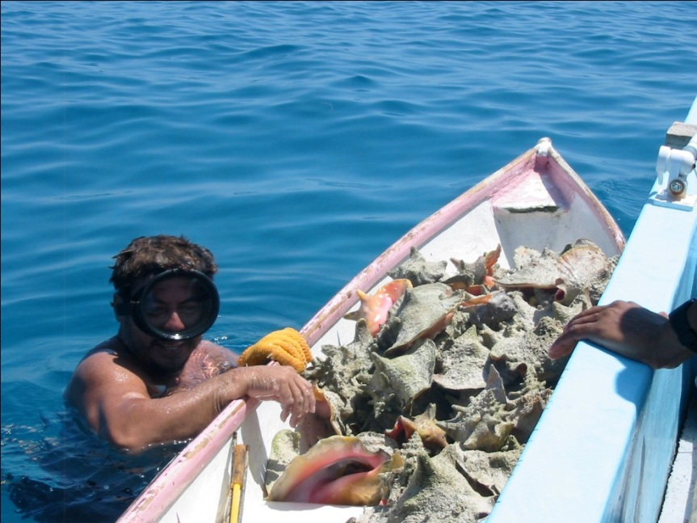
Increase in Fishers & Boats
Under Open Access, Belize's fisheries showing signs of overexploitation and decline
Source: Wade et al. 2011
No. Fisher Licenses
Revenue $
Number of fishermen increased from 1,731 in 2004 to 2,267 in 2009
Number of boats increased from 621 to 643 during same period
Yet revenue down ☹
James R. Foley MSc.| Toledo Institute for Development and Environment (TIDE) | Managed Access in Belize: ICRS 2012| Background

Slide 7
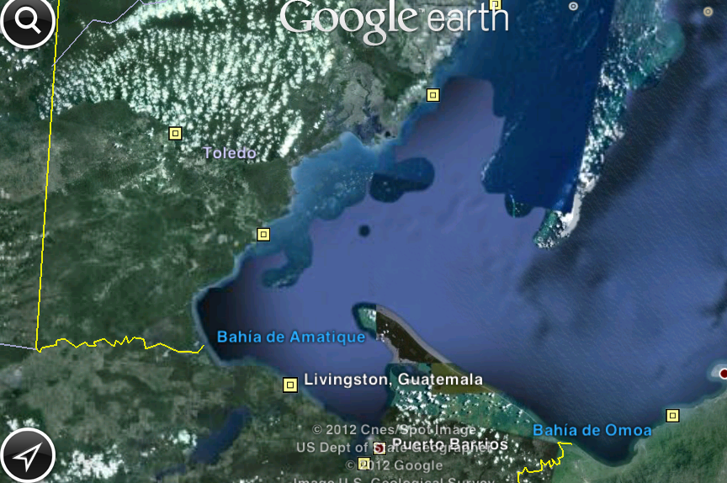
Open Access = Tragedy of Commons!
Belize
PHMR
Guatemala
Honduras
Too many fishermen chasing too few fish in fisheries that are mature, fully exploited or possibly in decline.
James R. Foley MSc.| Toledo Institute for Development and Environment (TIDE) | Managed Access in Belize: ICRS 2012| Background

Slide 8
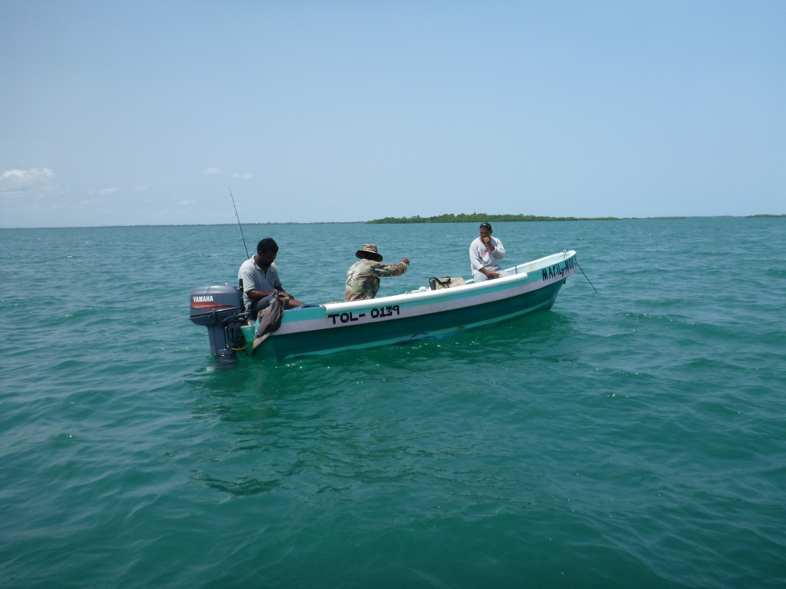
A Promising Solution:
Managed Access
Notes:
managed access system offers a fundamental trade-off in ending open access in favor of a rights system - special access for more responsibilities, and fishermen can opt to participate or not.

Slide 9
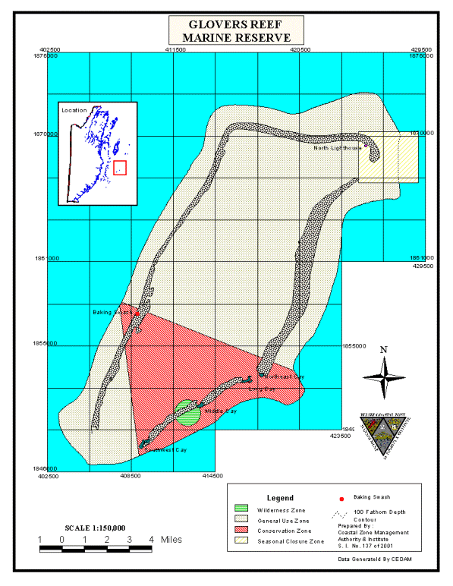
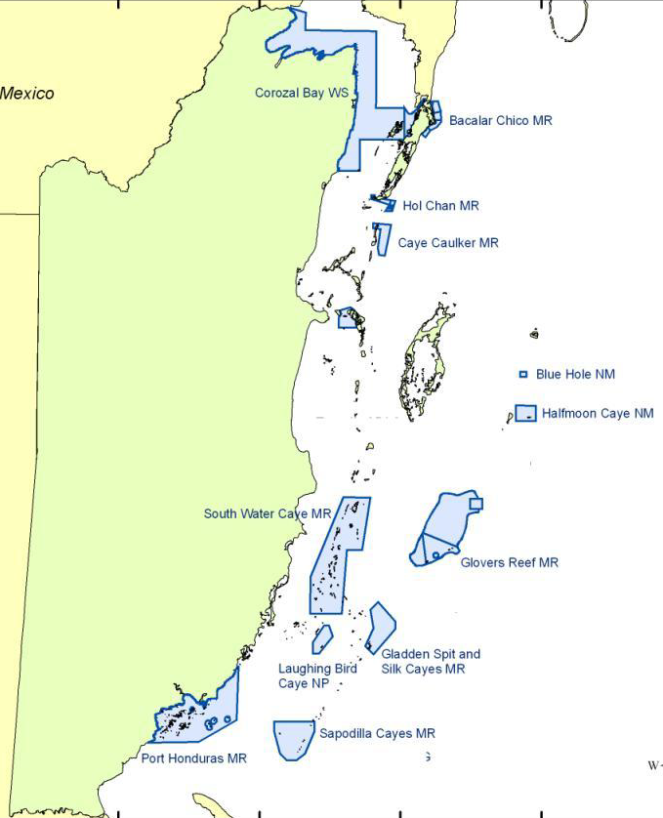
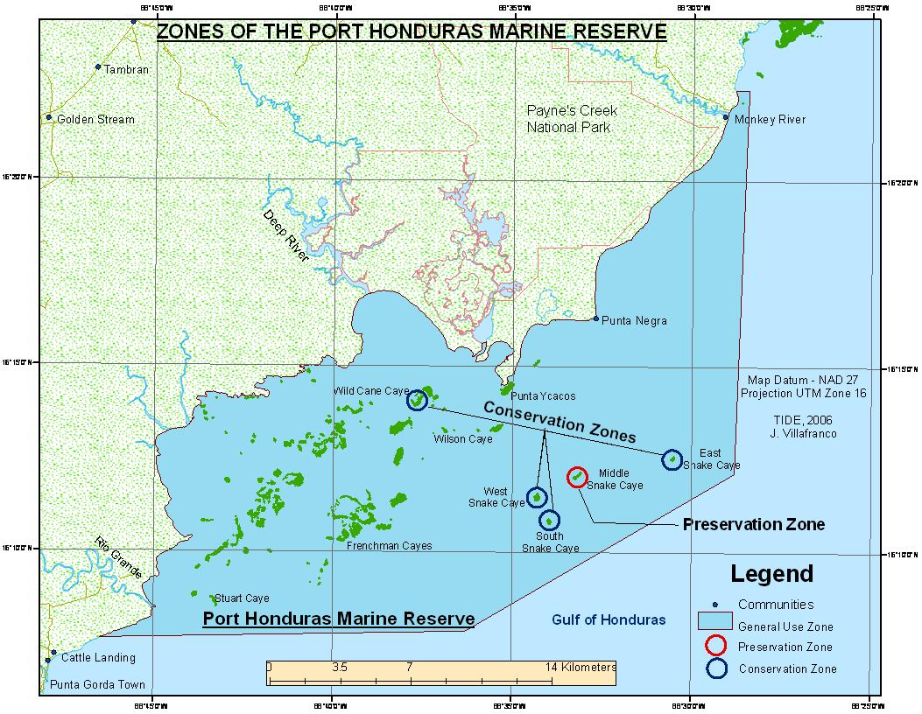

Where in Belize?
Belize City
Glovers Reef Marine Reserve
GRMR
PHMR
Port Honduras Marine Reserve
James R. Foley MSc.| Toledo Institute for Development and Environment (TIDE) | Managed Access in Belize: ICRS 2012| Description

Slide 10
Managed Access Task Force
Belize Fisheries Department (BFD):
  Leading Managed Access initiative
Environmental Defense Fund (EDF):
  Design & Technical expertise
Wildlife Conservation Society (WCS):
  Support BFD to manage Glover’s Reef Marine Reserve (GRMR)
Toledo Institute for Development & Environment (TIDE):
  Co-manage Port Honduras Marine Reserve (PHMR) with BFD
James R. Foley MSc.| Toledo Institute for Development and Environment (TIDE) | Managed Access in Belize: ICRS 2012| Description

Slide 11
Goals for Belize: Managed Access
Prevent decline in fisheries and increase abundance
Improved livelihoods and a prosperous industry
Collaboration between managers and fishermen for Participative Management
Improved management of fisheries
James R. Foley MSc.| Toledo Institute for Development and Environment (TIDE) | Managed Access in Belize: ICRS 2012| Description

Slide 12
List of Stakeholders
  Government of Belize:
    Belize Fisheries Department
    Ministry of Forestry, Fisheries and Sustainable Development
    Area Representatives
  Other Stakeholders:
    Fisheries Advisory Board
    Belize Fishermen Cooperative Association
    Glovers Reef Advisory Committee
    Fishermen Associations
    Fishermen (northern and southern Belize)
    NGOs: TIDE & WCS
James R. Foley MSc.| Toledo Institute for Development and Environment (TIDE) | Managed Access in Belize: ICRS 2012| Description

Slide 13
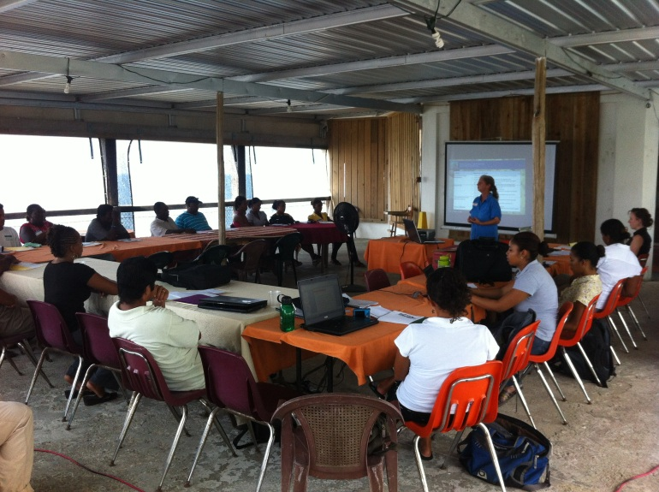
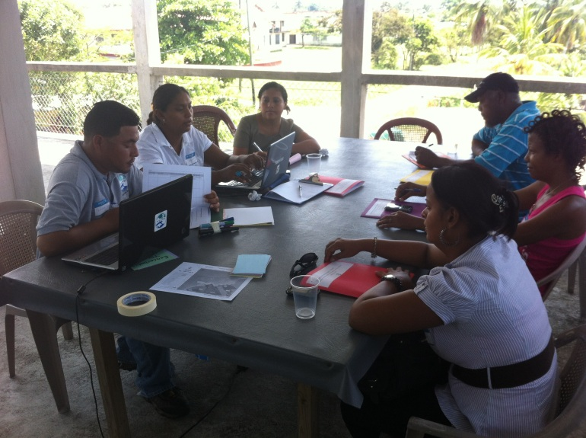
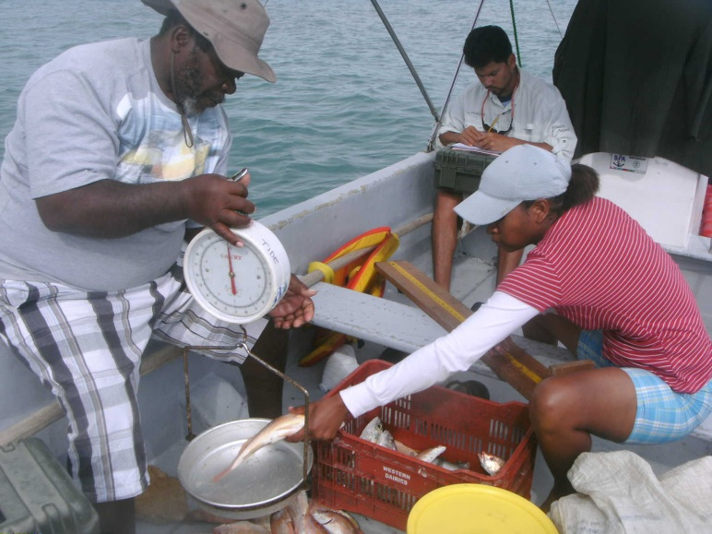
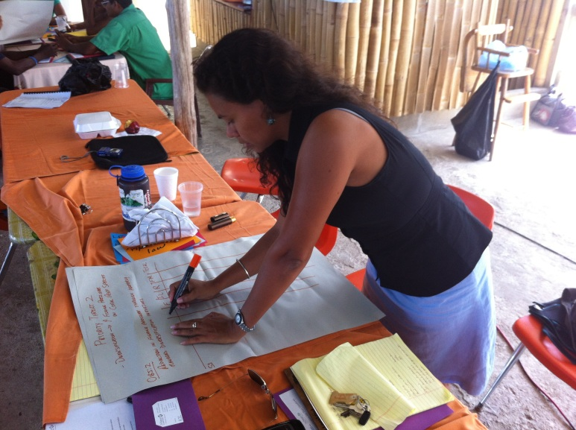
Education and Design Phase
James R. Foley MSc.| Toledo Institute for Development and Environment (TIDE) | Managed Access in Belize: ICRS 2012| Description

Slide 14
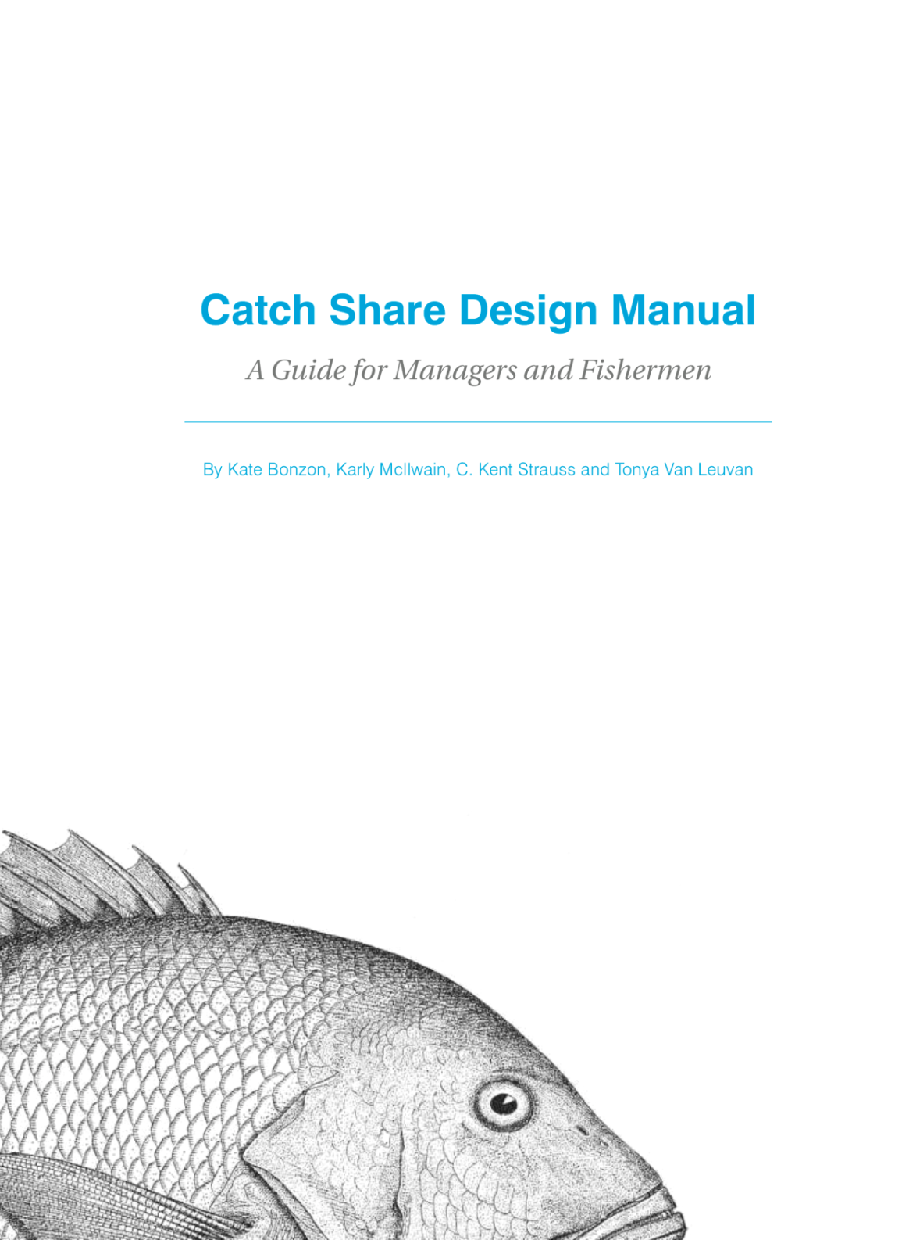
Design Manual
Developed with over 60 global experts
Step by step process
Flexible and customizable
Web Resources:
www.edf.org/CatchShareDesignCenter
James R. Foley MSc.| Toledo Institute for Development and Environment (TIDE) | Managed Access in Belize: ICRS 2012| Description
Notes:
As EDF has been studying and working on implementing catch shares, we have seen how few resources were available to managers and fishermen who might be trying to design and implement catch shares. While there is significant expertise worldwide, it had not really been condensed into a resource.
The Design Manual attempts to do just that. Design Manual is based on experience and was developed with more than 60 experts from all over the world, including New Zealand, Iceland, Australia, Canada, Chile, Denmark and more.
The Manual is not prescriptive, but it outlines a step by step process of the key questions that need to be answered in developing a catch share program and outlines the options that people have used. The key is that catch shares design is flexible.

Slide 15

Components of Managed Access
Rigorous licensing system:
  manage number of fishermen at pilot sites
Monitoring:
  Socio-economic data collection
  Fisheries-Dependent: Fishery data collection via log books
  Fisheries Independent: Underwater surveys
  Enforcement:
    Ensure compliance with regulations
Evaluation:
  Annual Diagnostics Report
Community Managed Access Committees (MACs)
James R. Foley MSc.| Toledo Institute for Development and Environment (TIDE) | Managed Access in Belize: ICRS 2012| Description

Slide 16
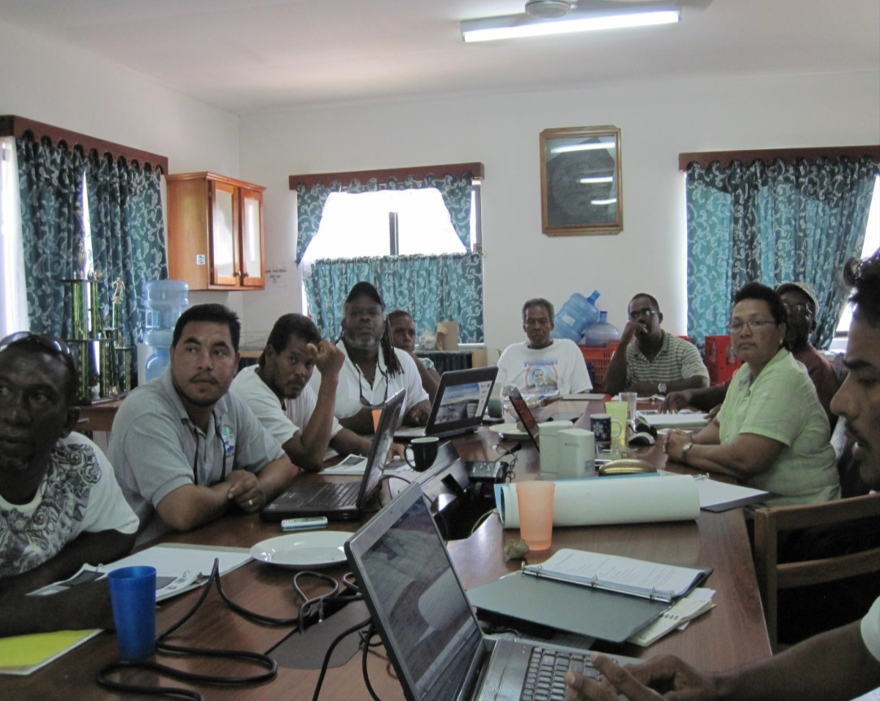
Community Managed Access Committees (MACs)
  ROLES:
  Community leadership
  Verify transparency in process
  Vetting of licenses
  Inform stakeholders
  Assist in improving data reporting
  Support Task Force
  Advise on reserve management
  Assist in Managed Access Design
Photo: Larry Epstein / EDF
James R. Foley MSc.| Toledo Institute for Development and Environment (TIDE) | Managed Access in Belize: ICRS 2012| Description
Notes:
Discuss key roles and responsibilities

Slide 17
Project Timeline to Date
 | 2008 |  |  |  |  |  |  |  |  |  |  |  | 2009 |  |  |  |  |  |  |  |  |  |  |  | 2010
Activity | J | F | M | A | M | J | J | A | S | O | N | D | J | F | M | A | M | J | J | A | S | O | N | D | J | F | M | A | M | J | J | A | S | O | N | D
Initial Assessment
Project Initiation
Consultations with Government
Partnership/Task Force Created
Initial Community Consultations
Workshops on Managed Access
Managed Access Design Process
Technical Development
TURFs, Licenses, and Monitoring
Community Committees Auth’d
Diagnostic of Pilot Sites
Strategic Planning for Expansion
Ongoing
Ongoing

Slide 18
Continued…
 | 2011 |  |  |  |  |  |  |  |  |  |  |  | 2012 |  |  |  |  |  |  |  |  |  |  |  | 2013
Activity | J | F | M | A | M | J | J | A | S | O | N | D | J | F | M | A | M | J | J | A | S | O | N | D | J | F | M | A | M | J | J | A | S | O | N | D
Initial Assessment
Project Initiation
Consultations with Government
Partnership/Task Force Created
Initial Community Consultations
Workshops on Managed Access
Managed Access Design Process
Technical Development
TURFs, Licenses, and Monitoring
Community Committees Auth’d
Diagnostic of Pilot Sites
Strategic Planning for Expansion
Since Sept 2008
Ongoing
Since July 2010
Ongoing
Ongoing

Slide 19
Major Milestones
Managed Access is Underway:
  Implementation began July 2011
Pilot projects at Glover’s Reef and Port Honduras Marine Reserves:
  >1 year complete!
Cabinet passed two authorizations in 2010 and 2011:
  Fisheries Advisory Board
  Community Committees
Evaluation process underway:
  Monitoring + 2012 Diagnostics Report
James R. Foley MSc.| Toledo Institute for Development and Environment (TIDE) | Managed Access in Belize: ICRS 2012| Description

Slide 20
Evaluating Success:
1. Monitoring &
Adaptive Management

Slide 21
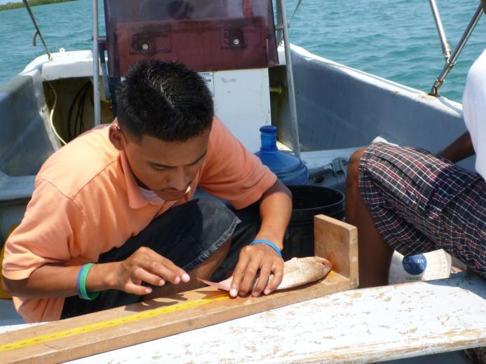
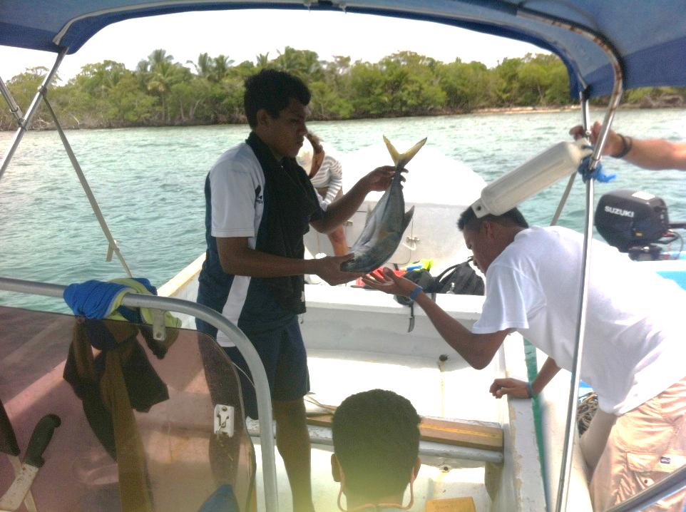
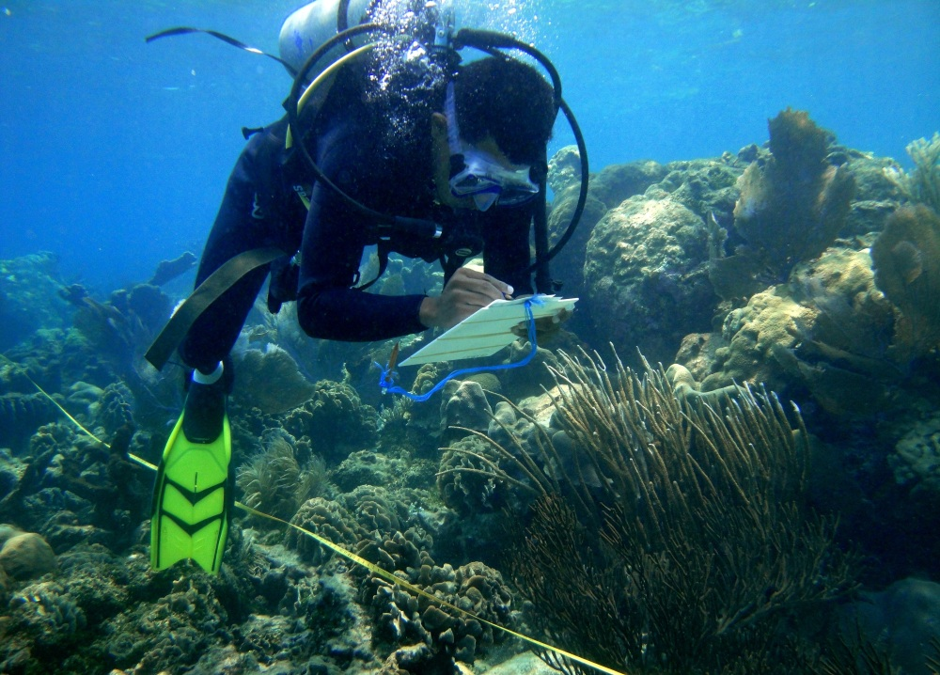
TIDE research to inform management of PHMR
Photo: Julie Robinson / TNC
James R. Foley MSc.| Toledo Institute for Development and Environment (TIDE) | Managed Access in Belize: ICRS 2012| Research to Inform Management

Slide 22
Evaluating Success:
2. Diagnostics Report

Slide 23
Diagnostics
Fishermen Assessment of Consultation Process
Source: Managed Access Diagnostic Report 2012
Fishermen approved of public consultation process
  82% attended at least one session
  35% attended three or more
  82% say ideas from fishermen incorporated into design
James R. Foley MSc.| Toledo Institute for Development and Environment (TIDE) | Managed Access in Belize: ICRS 2012| Diagnostics
Notes:
Managed Access mostly a success so far
Adaptive management enables fast response to procedures not yet running smoothly
Fishers mostly satisfied with implementation – there is a need to strengthen public communications

Slide 24
Diagnostics
Source: Managed Access Diagnostic Report 2012
Compliance with data submission very strong at GRMR (90%), some challenges to be addressed at PHMR (57%).
MACs effective – more capacity and legitimacy needed.
Enforcement effective - fishers and managers already seeing benefits.
Fishers behavior changing positively since implementation.
James R. Foley MSc.| Toledo Institute for Development and Environment (TIDE) | Managed Access in Belize: ICRS 2012| Diagnostics

Slide 25
Acknowledgements
Government of Belize
Belize Fisheries Department
Hon. Lisel Alamilla: Minister of Forestry, Fisheries and Sustainable Development
Northern and National Fishermen Cooperatives
Fishermen of Belize
Environmental Defense Fund (EDF)
Summit Foundation
Oak Foundation
Wildlife Conservation Society
Toledo Institute for Development and Environment (TIDE)
The Nature Conservancy (TNC)
James R. Foley MSc.| Toledo Institute for Development and Environment (TIDE) | Managed Access in Belize: ICRS 2012| Acknowledgements

Slide 26
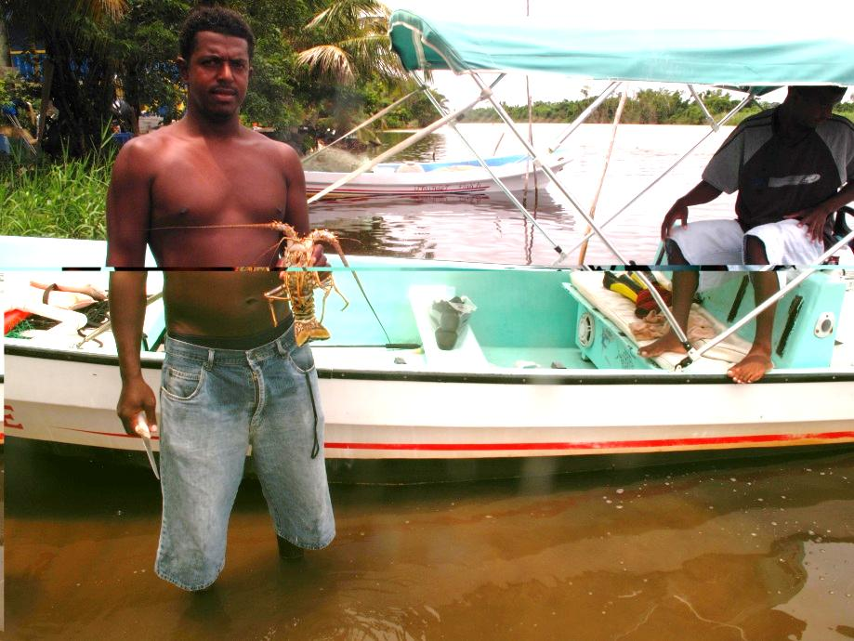

Thank you
James R. Foley, MSc.
Toledo Institute for Development & Environment (TIDE) Belize
+ 501 722-2274
jfoley@tidebelize.org | www.tidebelize.org
Attendance supported by

